Slide 1

BY:-
SRISHTI RANJAN

Slide 2


R LIBRARY

Slide 3
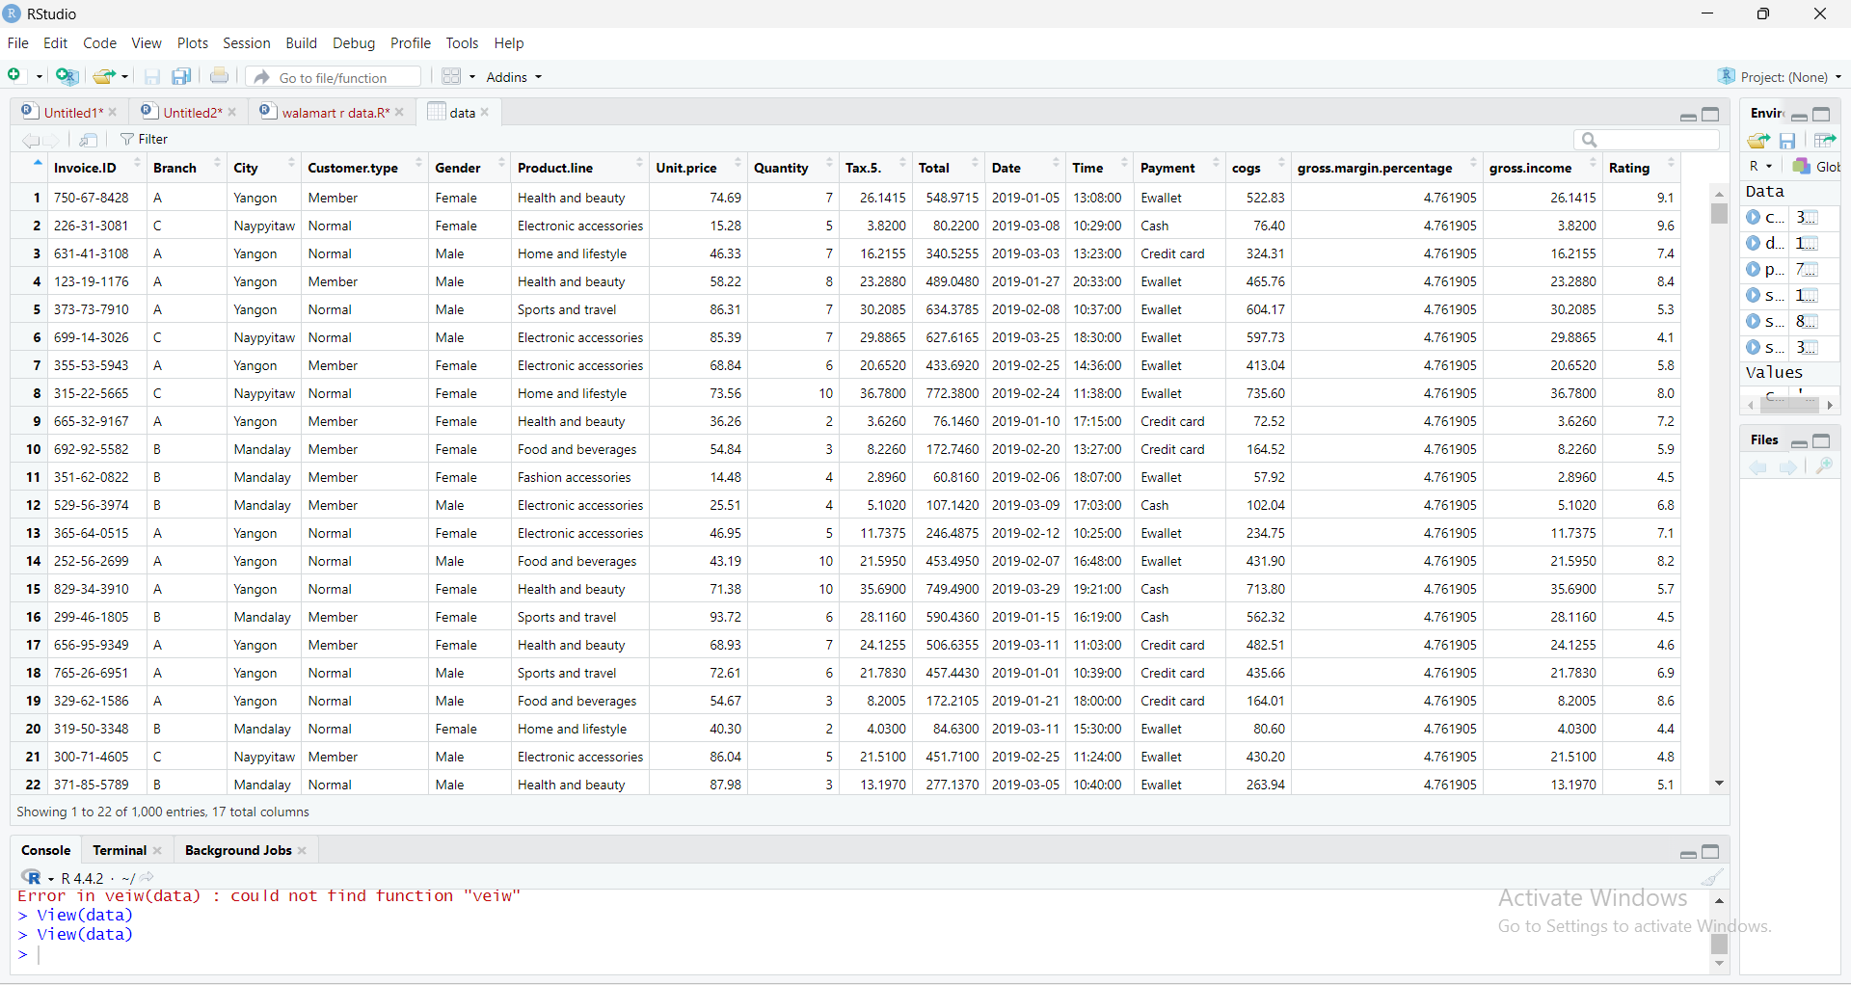
VIEW OF THE DATASET

Slide 4
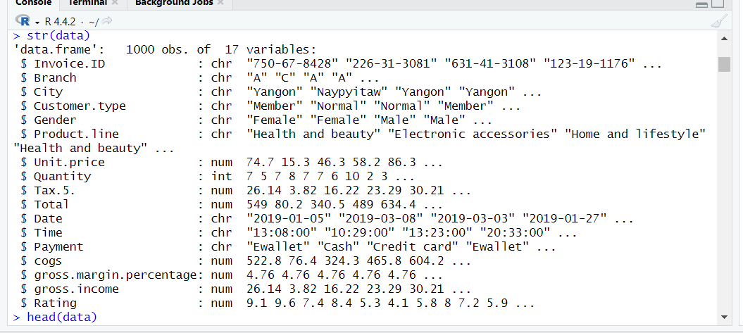
DATA STRUCTURE

Slide 5
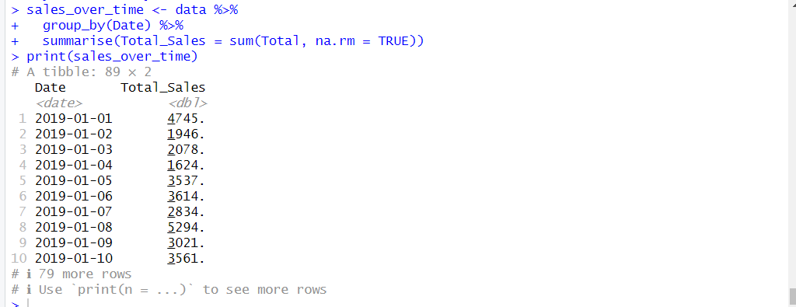

SALES OVER TIMES

Slide 6
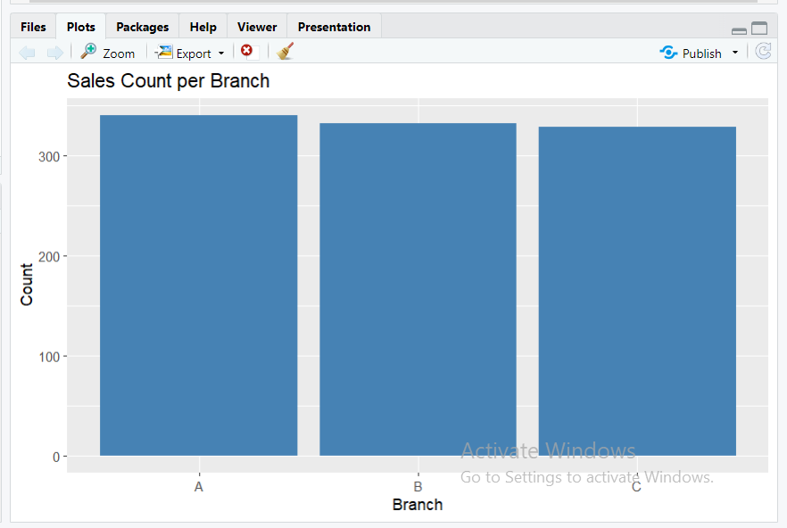

COUNT OF SALES PER BRANCH

Slide 7
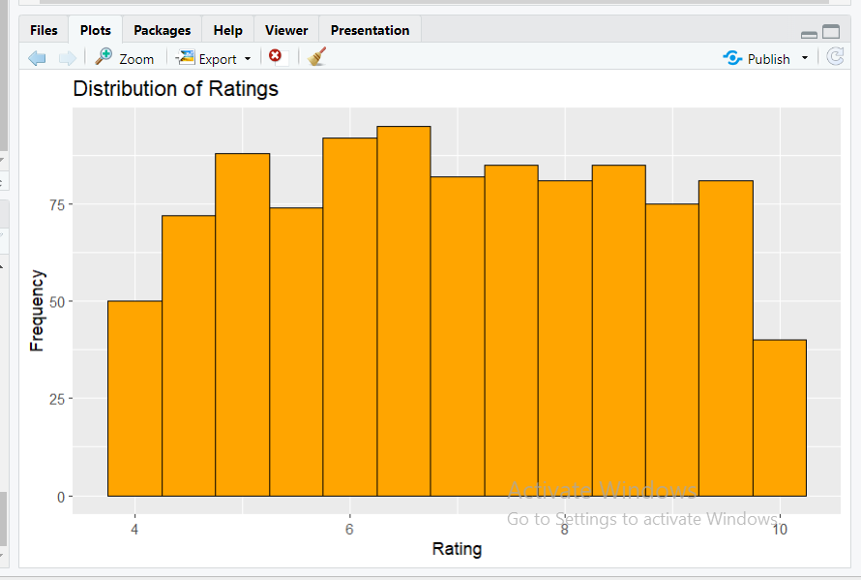

DISTRIBUTION OF RATING

Slide 8
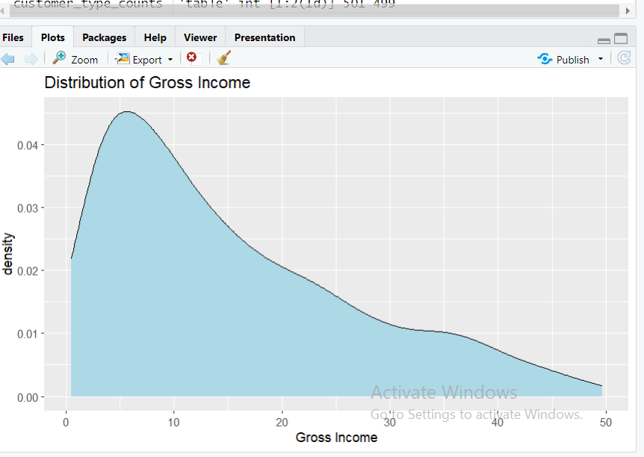

GROSS INCOME

Slide 9
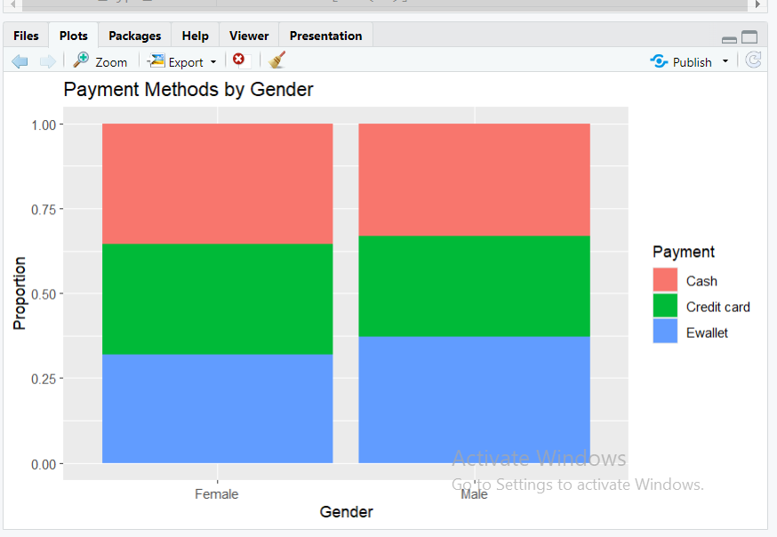

PAYMENT METHOD AS PER GENDER

Slide 10
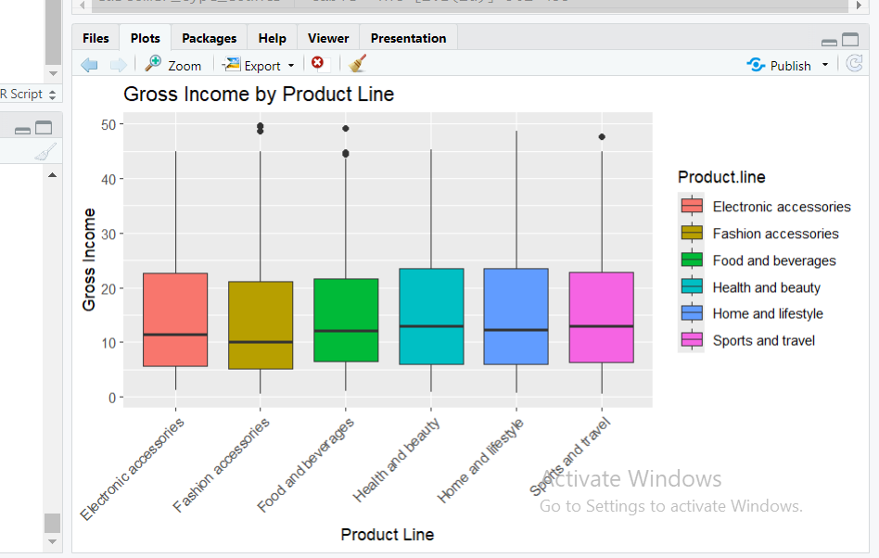

GROSS INCOME BY PRODUCT LINE

